Slide 1
Pre-presentation demonstration
Optional Hook:
Drop a maple seed and/or horse chestnut dropped from height (if possible get student to climb on something and drop from a tall height)
Demonstration of dandelion: get volunteer to blow on a dandelion
Get students questioning what the topic will be.
Notes:
Without telling students what you’ll be talking about have them guess!
-Have a student blow on a dandelion to see seeds disperse
-Or have students throw cleavers/burdock at each other to see how seeds stick.

Slide 2
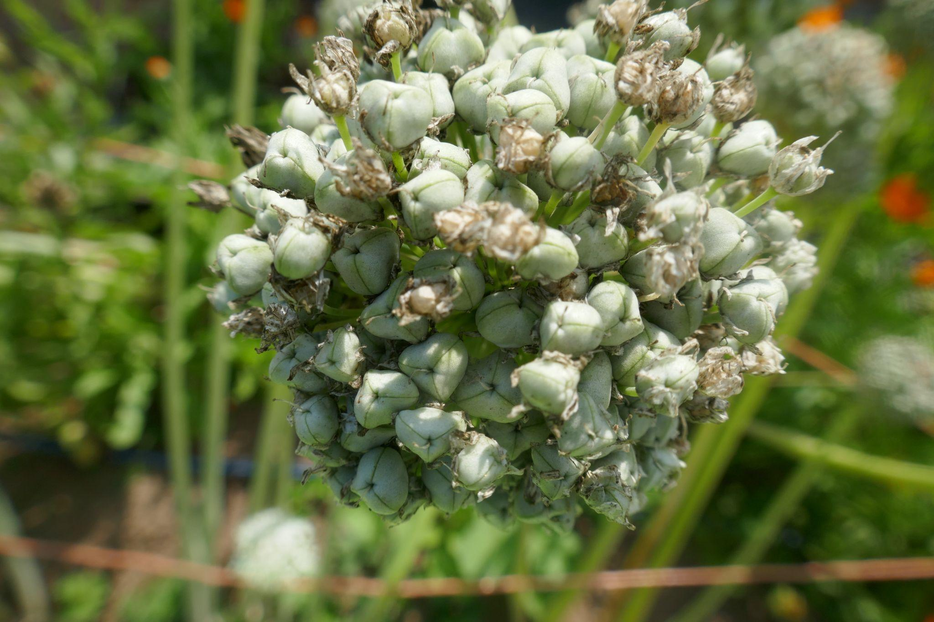
School Seed Stewardship
Bite Size Lessons
How seeds travel
FarmFolk CityFolk

Slide 3
Seed Acknowledgement
We care for seeds because
they have always cared for us
Notes:
Indigenous SeedKeepers Network: “We understand that seeds are our precious collective inheritance and it is our responsibility to care for the seeds as part of our responsibility to feed and nourish ourselves and future generations.”
Seeds and humans have a long multigenerational relationship. Many indigenous cultures see them as ancestors as opposed to the colonial perspective which can see seeds as something to be hoarded and controlled.
We care for seeds because they have always cared for us.

Slide 4
Why are seeds important?
Where do they come from?
Are they important? Why?
Why would a plant put so much energy into producing a seed?
What’s the biggest seed you can think of?
Notes:
Where do they come from: They come from plants. To dig deeper (optional) research a certain plant’s country of origin.
Seeds are important because they are the genetic bank of plant information and all life. They are the blueprint for a plant. Important as they provide us food for this year, and generate more seeds for next year.
The lifecycle of a plant needs to continue after it has died so they put a lot of energy into making seed to have offspring. Some will die after they have produced seeds and some, like perennials will make seeds each year.
Some big seeds: Coconut is the biggest, Avocado pits, Mango

Slide 5
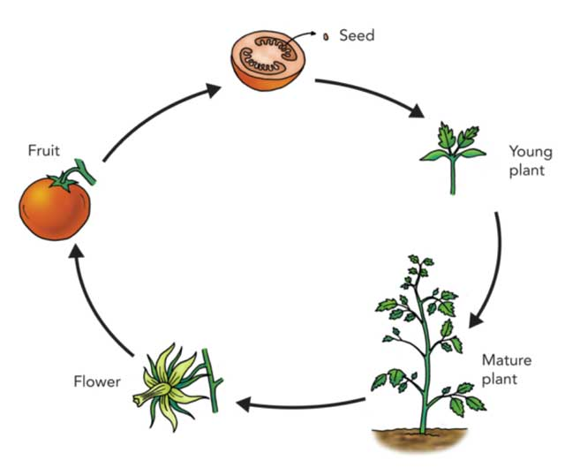
Lifecycle of a Plant
Who has put a seed in soil before?
What we know: When you put a seed in the ground, it grows into a plant
But where does the seed come from to begin with? How does it get to where it starts growing?
Photo Credit: science4fun.info/life-cycle-of-plants
Notes:
The questions above can be asked just to inspire curiosity or be answered with the following.
-Seeds can come from inside fruits, attach to fluff, pods.
-Ways that seeds move: wind, humans, animals, water -will be explored further

Slide 6
How Do Seeds Move?

Slide 7
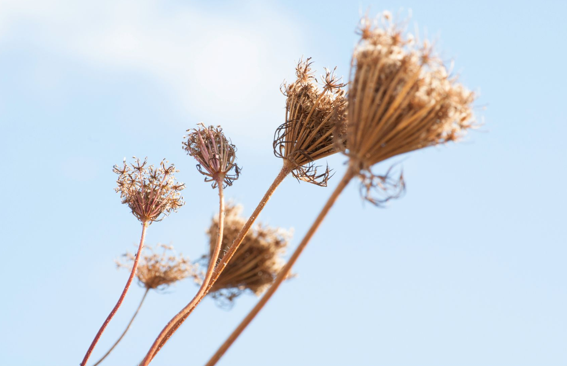
How Do Seeds Move Around?
Which are true which are false
A) By wind
B) By water
C) By shaking
D) By explosions
Notes:
See answers on next slide

Slide 8
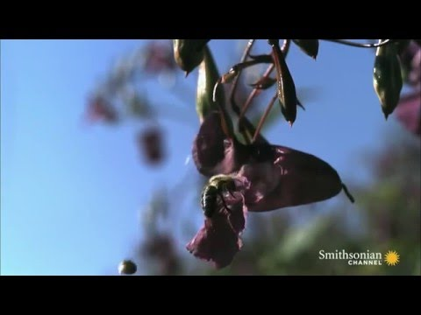
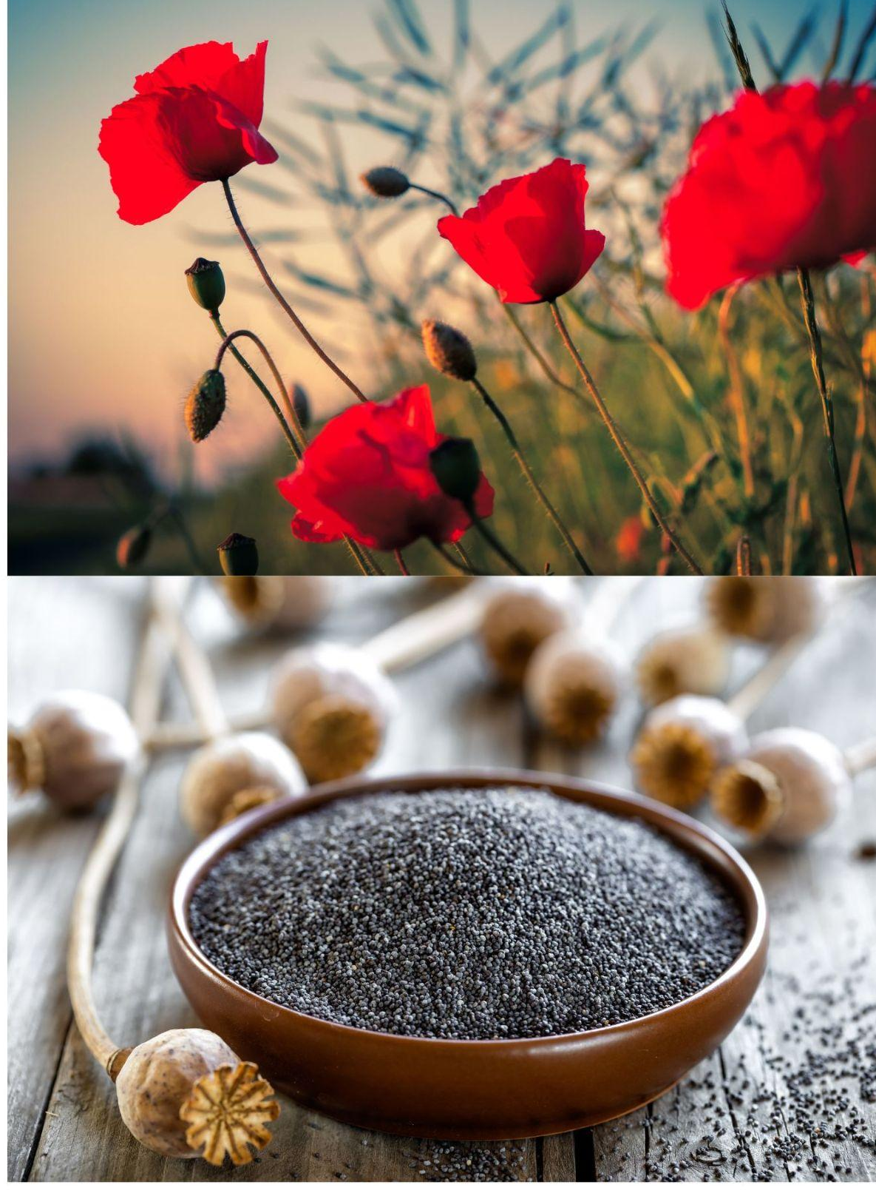
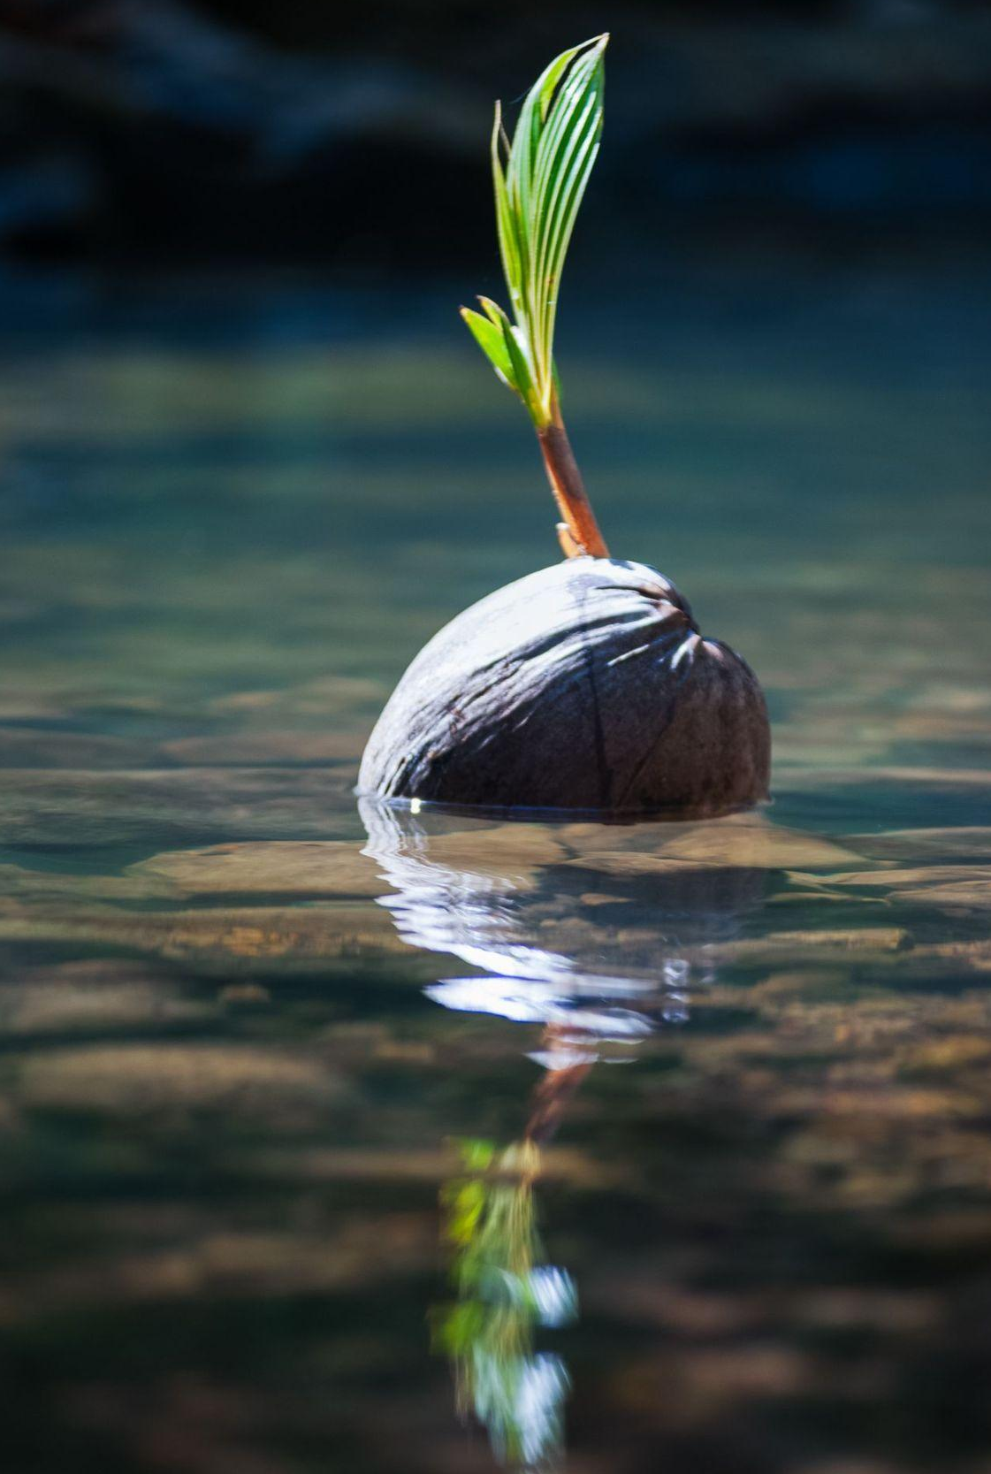
How Do Seeds Move Around?
By popping/exploding
By wind
Shakers
By water
Notes:
ALL are true!
https://www.youtube.com/watch?v=OB0P3mx_lxY
Great to have physical examples of each i.e. WIND: dandelions or lettuce, WATER: a coconut (the biggest seed) or cranberries that float, SHAKERS: poppies or gourds that shake, and video of exploding flowers and cucumbers

Slide 9
How Do Seeds Move Around?
Which are true which are false
A) Drop and Roll
B) Poop
C) Like Velcro
D) My Uncle Bob
Notes:
See answers on next slide

Slide 10
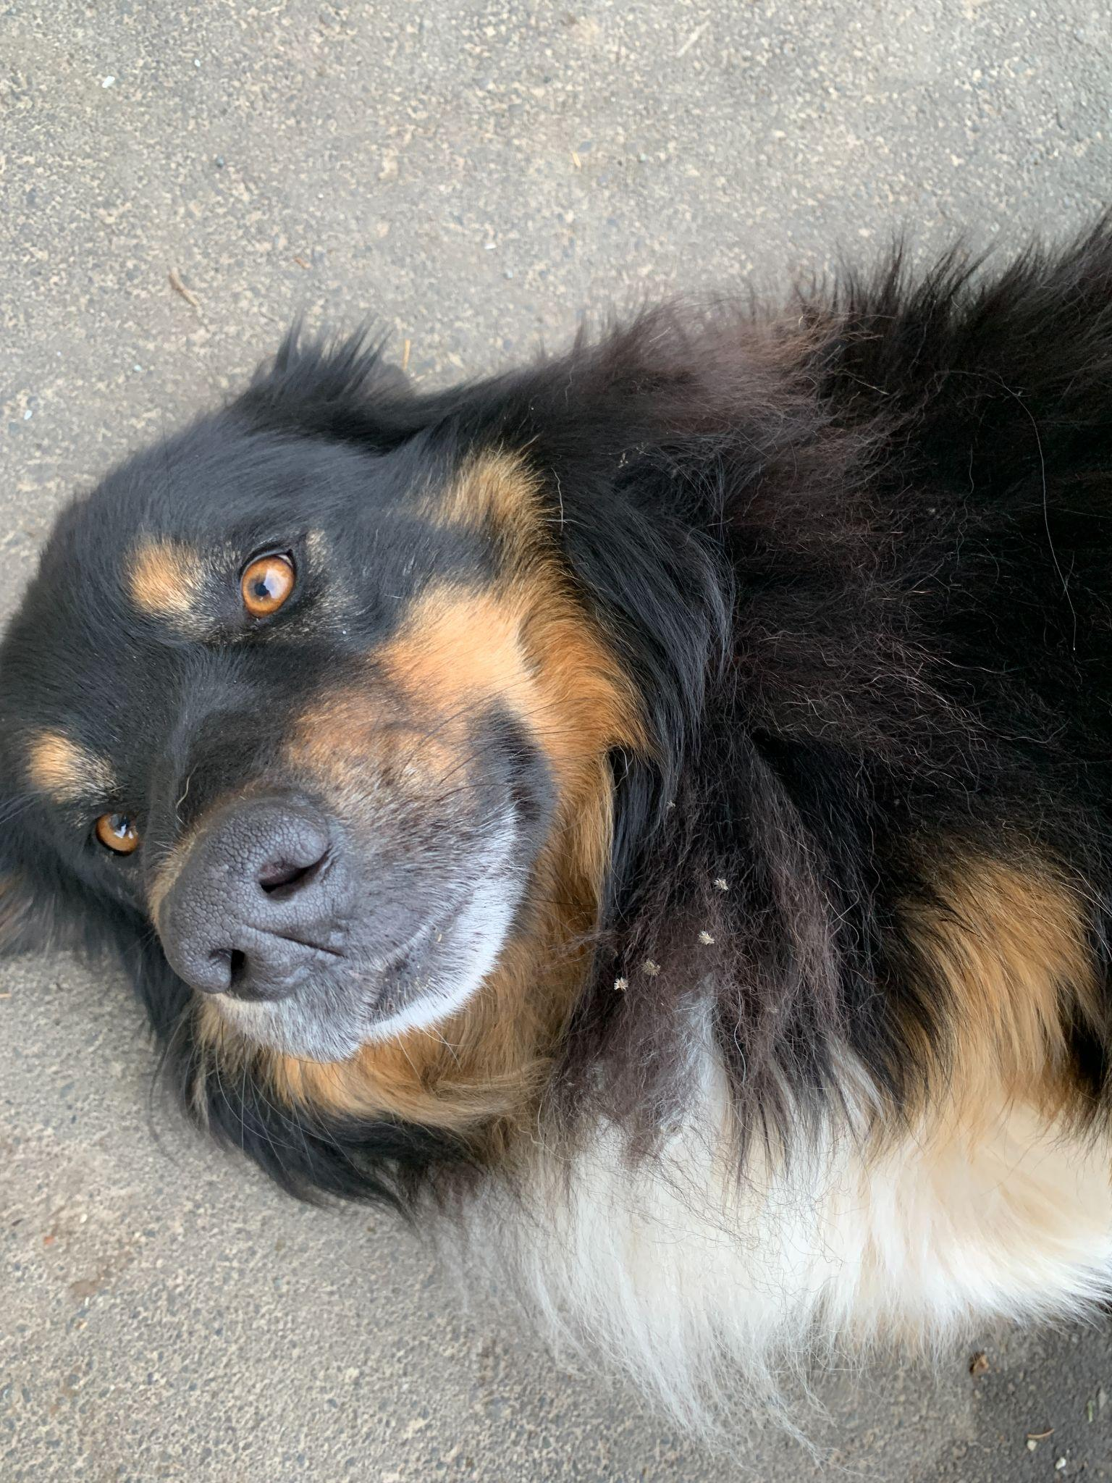
How Do Seeds Move Around?
Which are true which are false
A) Drop and Roll (TRUE: horse chestnuts)
B) Poop (TRUE: berries, birds, bears)
C) Velcro (TRUE: burrs on socks, animals)
D) My Uncle Bob (well…)
Chestnuts fall and break open
Farm dog Barney full of burrs
Giant burrs
Notes:
All are TRUE!
Drop and Roll: Hard outer shell has to drop from height in order to break and rolls to plant itself even further away
Poop: Animals like bears and birds eat seeds and berries then move around and poop them in new locations
Burrs work like velcro: they hook to animal fur or human socks to plant themselves further away
My uncle BOB alludes to humans as the final way of seeds moving around.
Great to have physical examples of each: horse chestnuts with both spiky covering and seed, burdock or other burrs and showing how they stick to material.

Slide 11
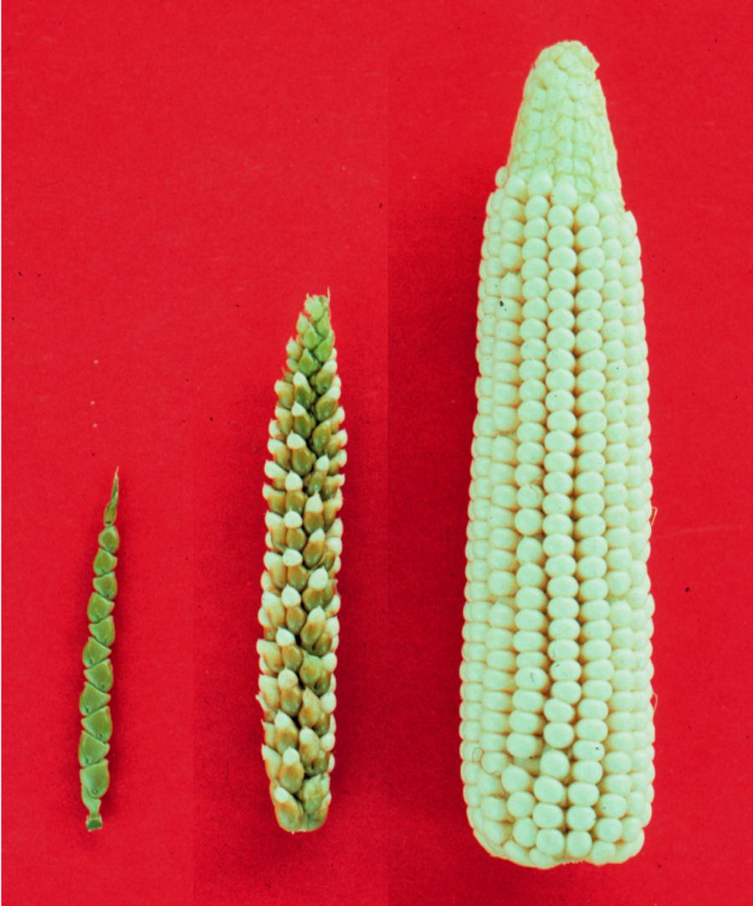
My Uncle Bob: Humans Role in Seed Dispersal
Humans have a long history of domesticating wild species. Look at the picture of corn before it was bred to be a cultivated variety. You can see humans select for increased food yield.
However, this domestication comes with a big responsibility. It means we need to steward these seeds. This means it’s our responsibility to save seeds each year of crop varieties.
Wild species will disperse on their own, oftentimes crop varieties need humans to ensure their survival.
Photo credit: https://tdaynard.com/2020/01/12/how-corn-began/
Notes:
Read about how corn began (image credit): https://tdaynard.com/2020/01/12/how-corn-began/

Slide 12
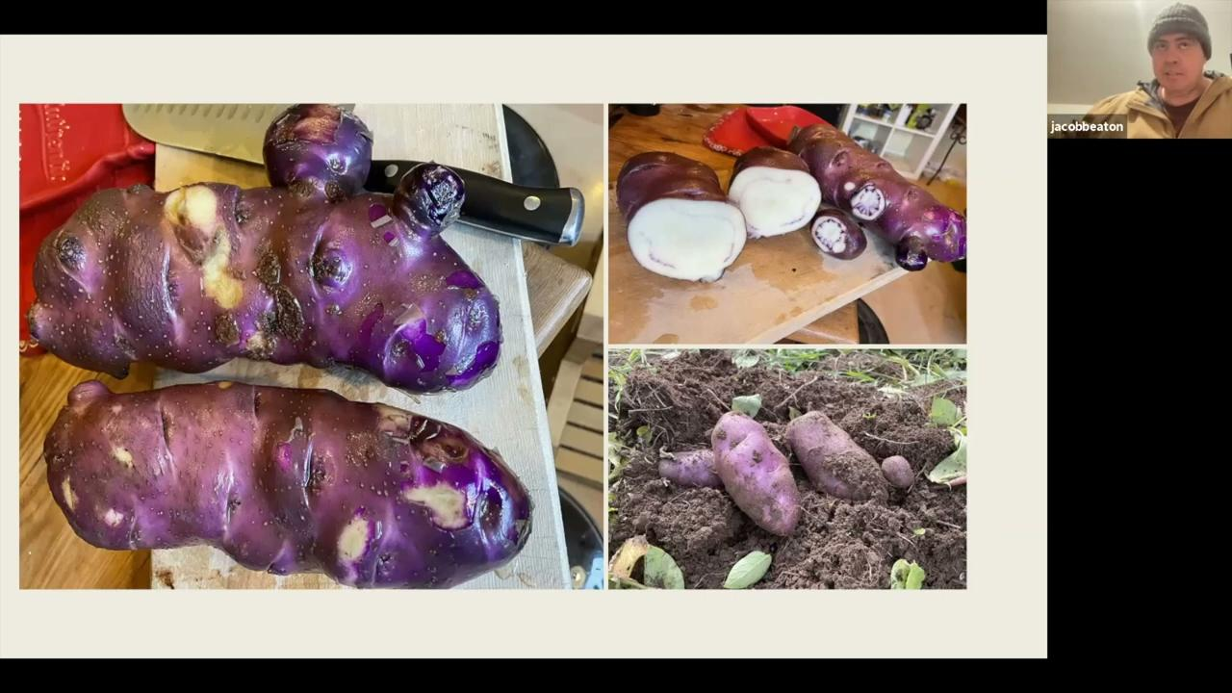
My Uncle Bob…or My Uncle Jacob!
Indigenous Seed Story - Jacob Beaton, Tea Creek
Notes:
HUMANS are a final way of dispersing seeds! Question that might come up: Is a potato a seed? Most people don’t plant potatoes from seed, but use tubers (as clones) to propagate plants, much like garlic.

Slide 13
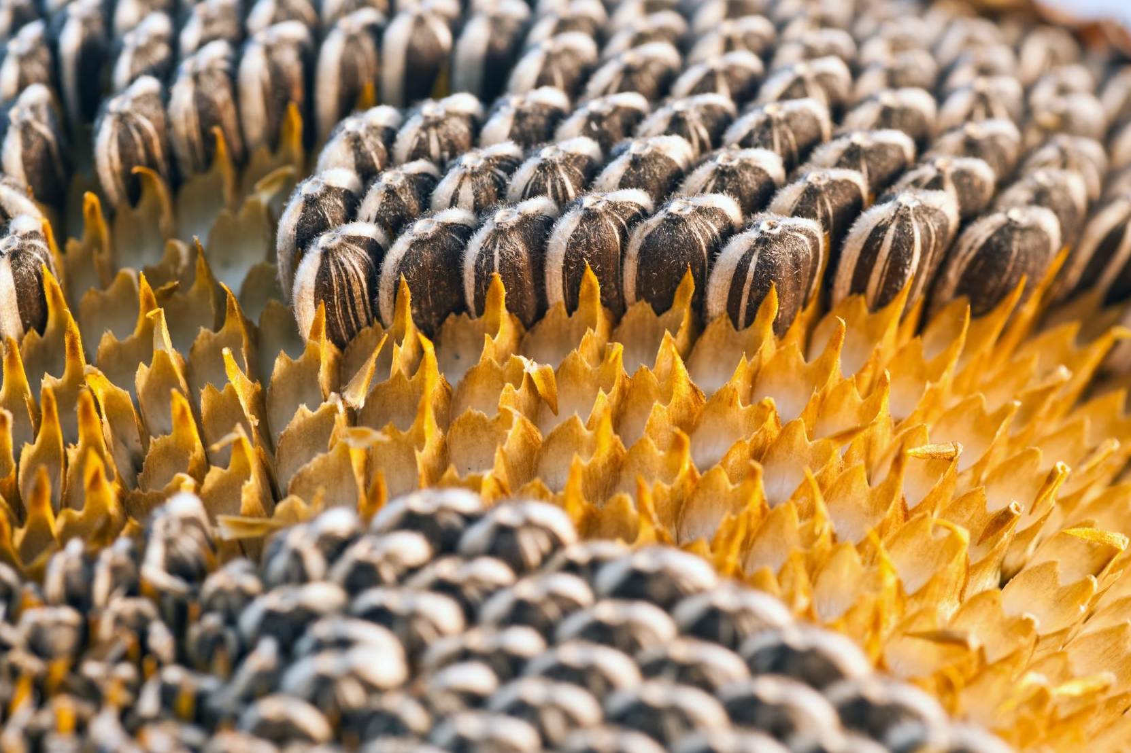
Seeds for Survival
All these ways seeds travel ensures that they stay alive!
Because if you travel to more places and have more options for your growing conditions, then there are more possibilities for your species to survive.

Slide 14
Activity Options - General Seed Knowledge
Seed Matching Game: To familiarize ourselves with seeds from different plants we will play the seed matching game. Each deck of cards has one plant that has 4 stages of growth. Start with the deck with photographs face up. See if you can match 4 pictures to each plant without looking at the label on the back of the card.
(This can also be played as a game of go fish)

Slide 15
Activities Specific To Dispersal
Drawings of different mechanisms of seed dispersal with handouts (upcoming slide or see pp. 40-41 of SPEC)
Tray of seeds to ‘test’ for dispersal method (see p. 38 of SPEC)
For Grades K-4 See Unit 2, page 37-41 of the SPEC_July18_lesson_book.pdf
Seed dispersal LAB for middle/high school. Predictions, Experiment, Distance Calculations as laid out in Chicago Botanic Garden document
For Grade 7-9 See the Chicago Botanical Seed Dispersal activities

Slide 16
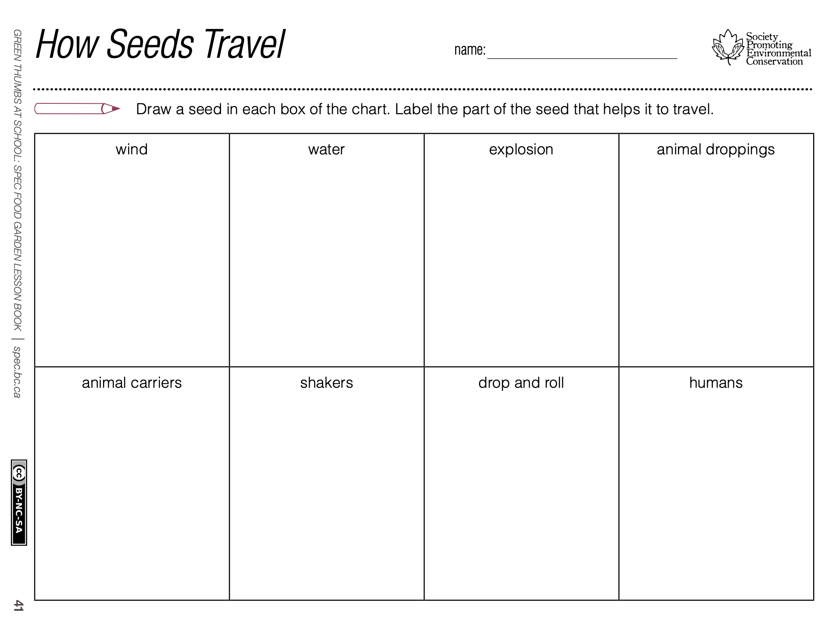
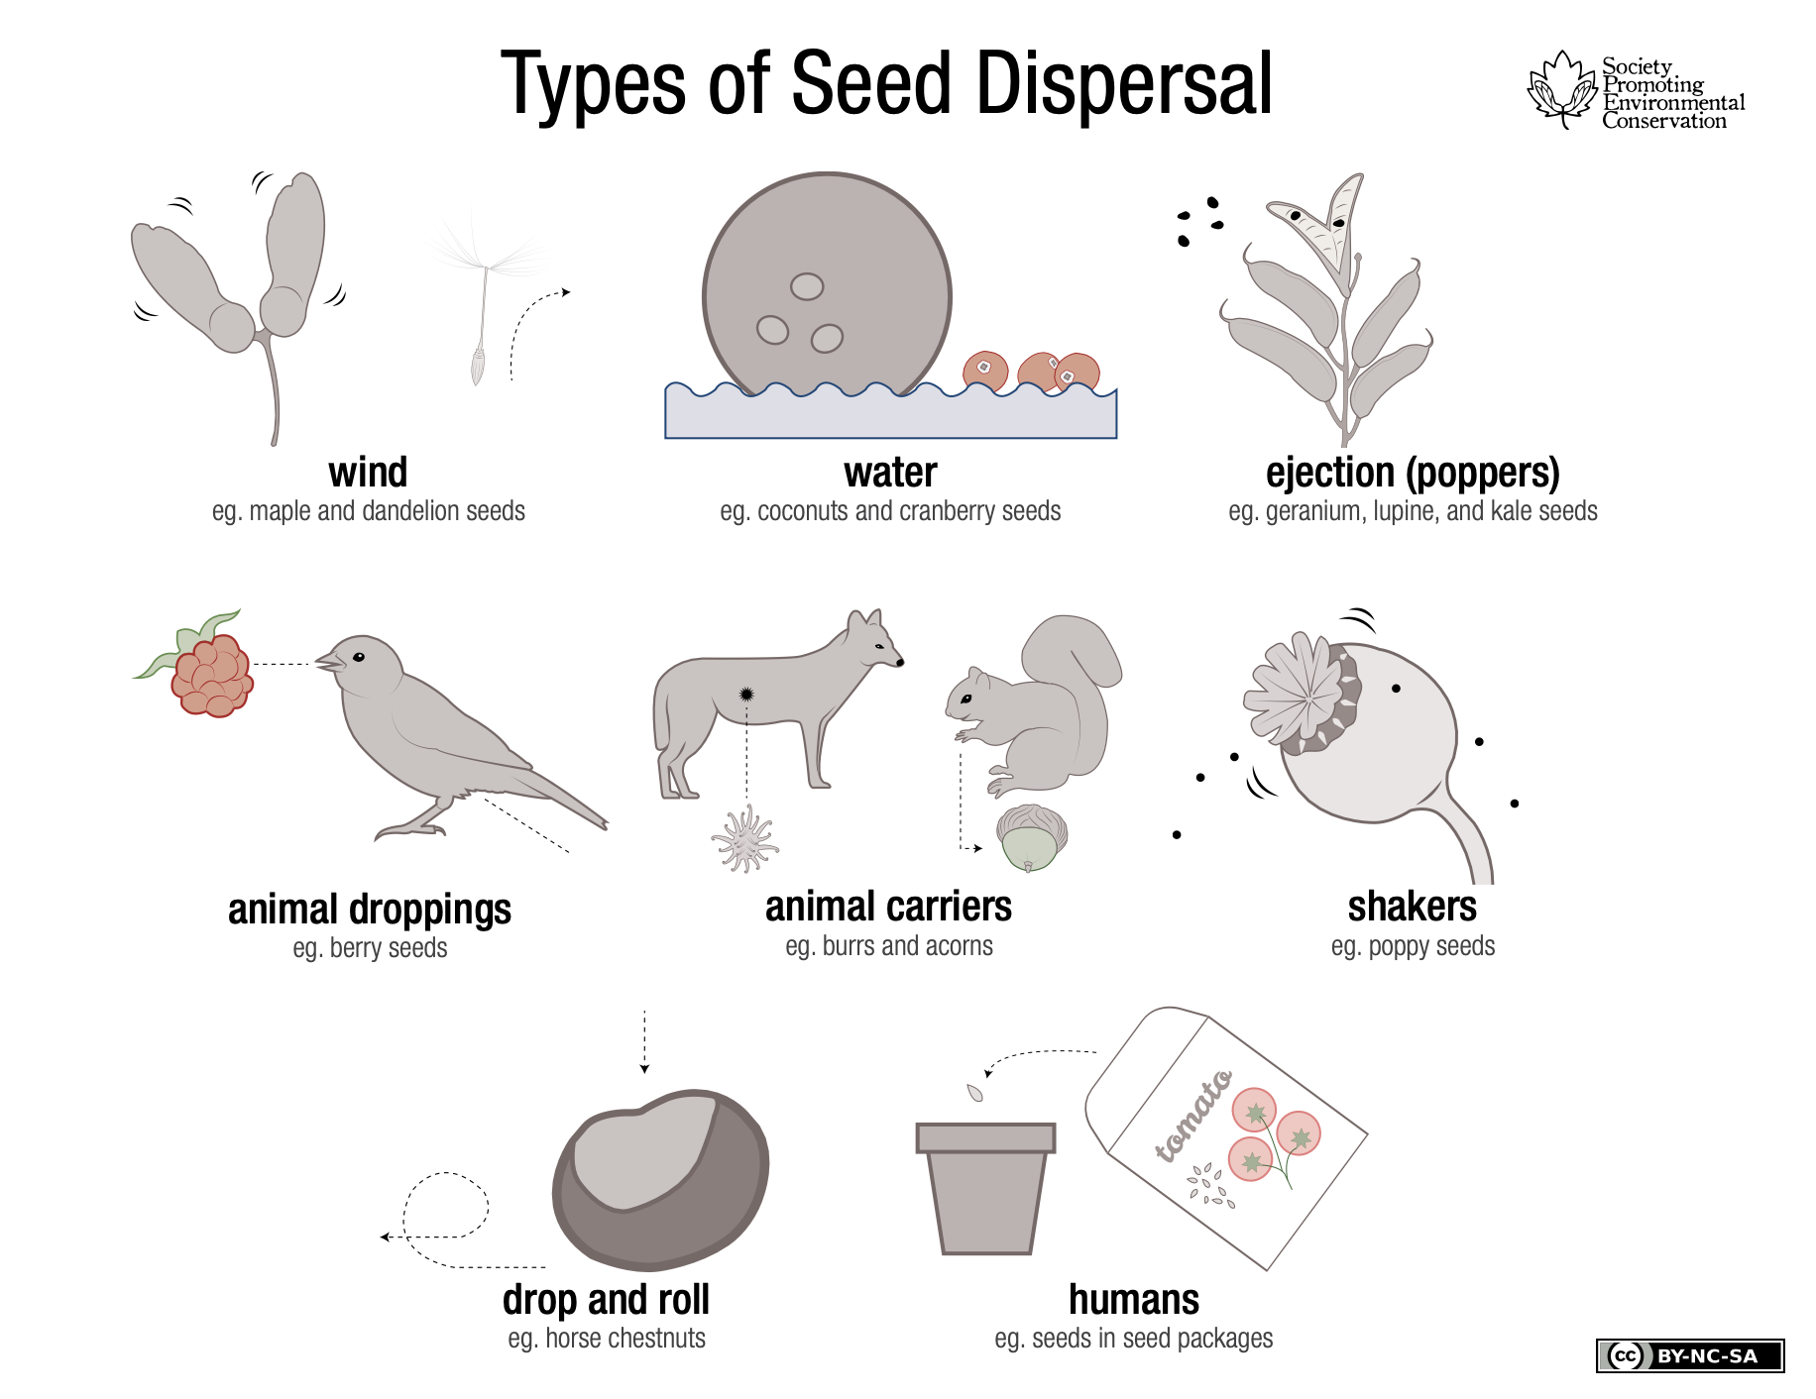
Activity Options - Drawing
Taken From Unit 2, page 37-41 of the SPEC_July18_lesson_book.pdf

