Slide 1
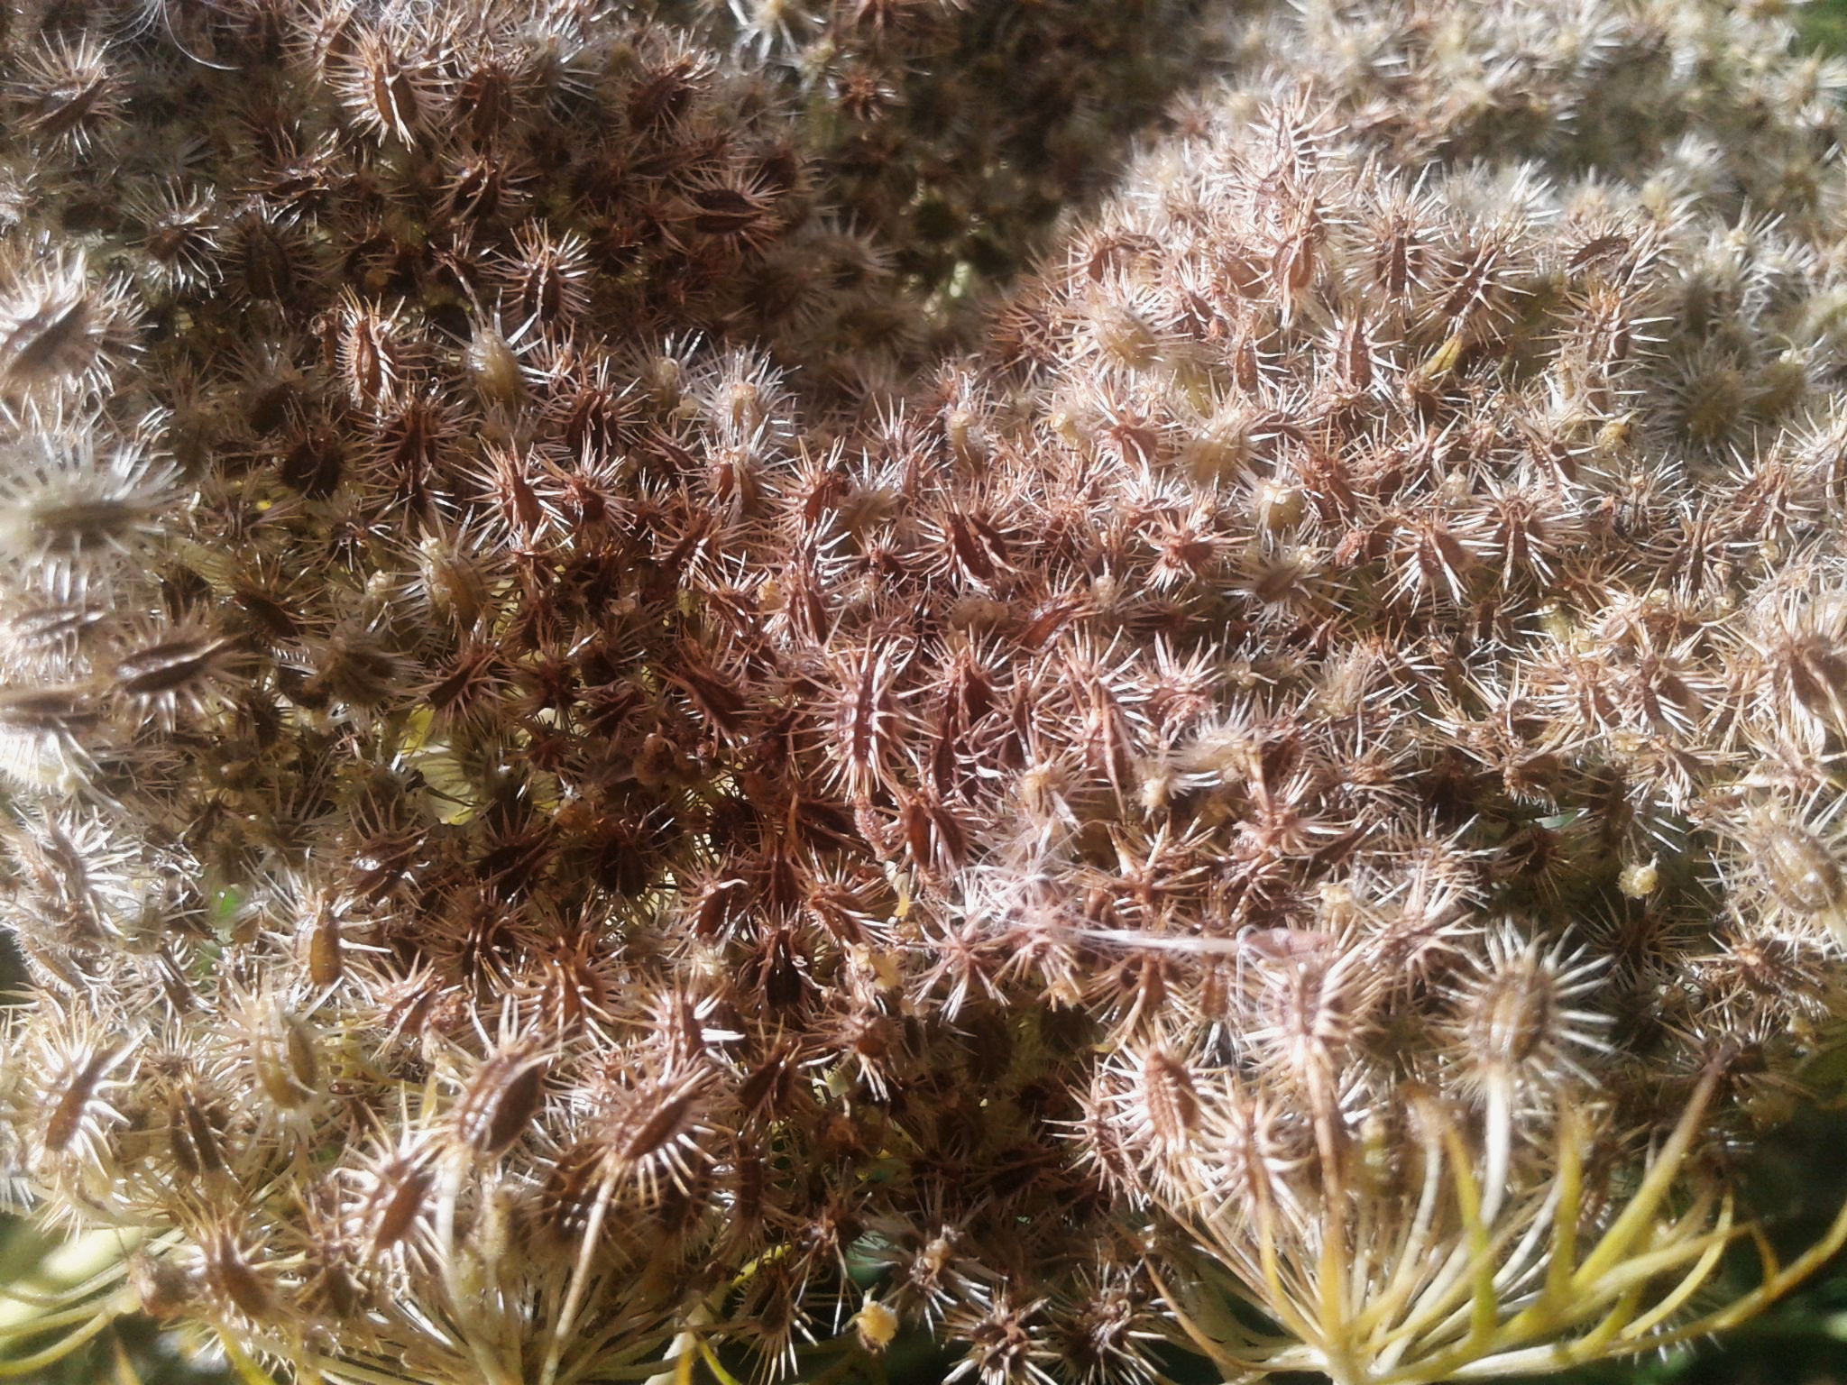
Farm To School
Seed Saving Bite Size Lessons
Seed Stewardship
FarmFolk CityFolk

Slide 2
Seed Acknowledgement
We care for seeds because
they have always cared for us

Slide 3
Seed Stories
"There's this big difference between just looking at seeds like biological materials that are important for farming," said Alejandro Argumedo, who is Quechua from Ayacucho, Peru. "Indigenous people see them more as members of an extended family and to which you have to [tend] with care. Because there will be a reciprocity — they will be providing you ... food, will be caring about you."
Indigenous Seed Keepers Network Video
Notes:
Reference: https://www.cbc.ca/news/science/what-on-earth-indigenous-seeds-tradition-1.5617755
https://nativefoodalliance.org/our-programs-2/indigenous-seedkeepers-network/
(Approx 4 minutes) Youtube Link: https://www.youtube.com/watch?v=IooHPLjXi2g&t=2s

Slide 4
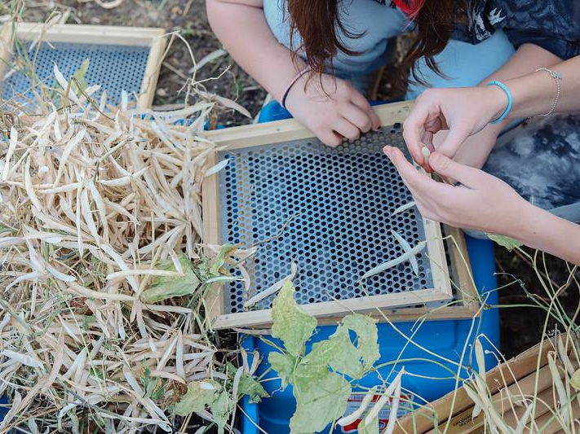
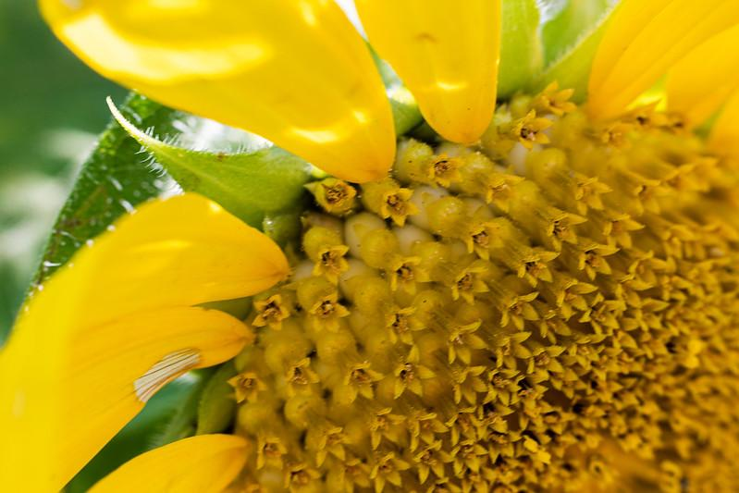
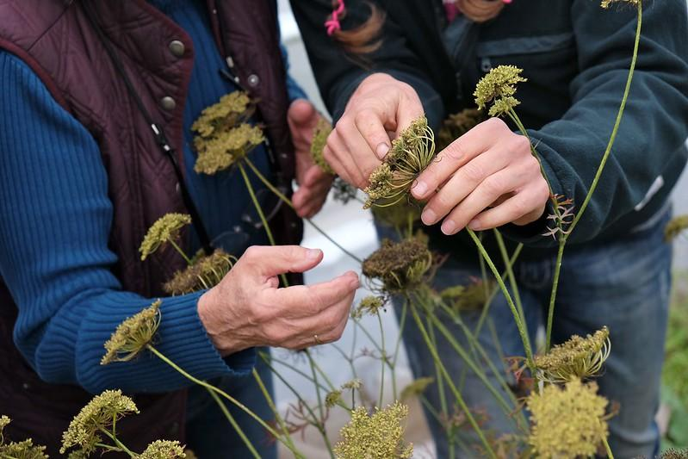
Why would you want to seed save?
Notes:
Generate a list on whiteboard/flipchart, or smartboard to record student answers

Slide 5
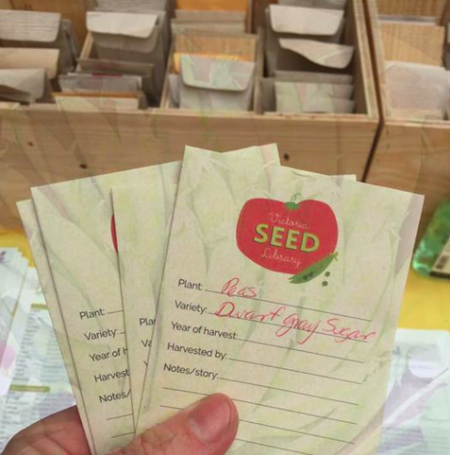
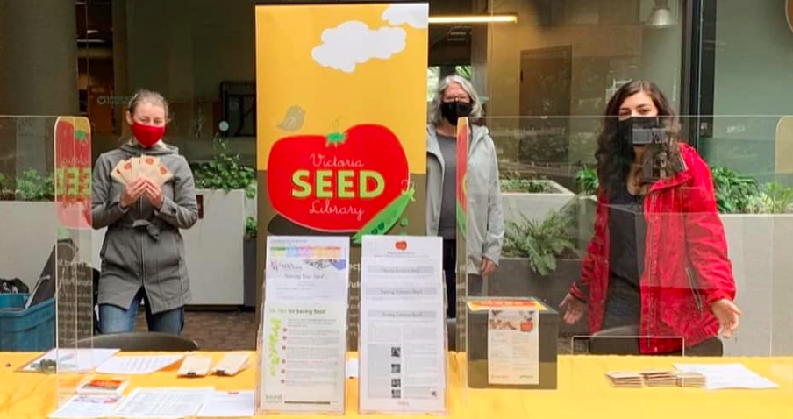
Why do seeds need preserving?
Seed libraries: People ‘sign out’ seeds to grow, to be able to return the seeds from their plants to the library. This way the seeds keep adapting over time and we don’t lose any specific variety because of the seed drying out and dying.
Image Credit: Seeds of Diversity, seeds.ca
Notes:
Use FarmFolk CityFolk’s Seed Library directory to find a seed library near you: https://farmfolkcityfolk.ca/find-seeds/seed-libraries/
If possible, reach out to your local Seed Library organizer and see if they are willing to join you in the classroom for a talk about seed saving or explain how their seed library operates. Each Seed Library operates differently (see Seed Library presentation to learn more).
Another fun activity is to borrow seeds from your local Seed Library to grow them in your school garden.

Slide 6
Why do seeds need preserving?
Image Credit: Seeds.ca
Seeds of Diversity Community Grow-outs:
Save a rare seed! Sometimes there are varieties only offered by one grower, so by growing it out it will double the diversity of this variety!
If there any local seed savers or libraries that have a variety they want to grow out; your garden could help them do that.
Notes:
Check out the Seeds of Diversity website for more information: https://seeds.ca/

Slide 7
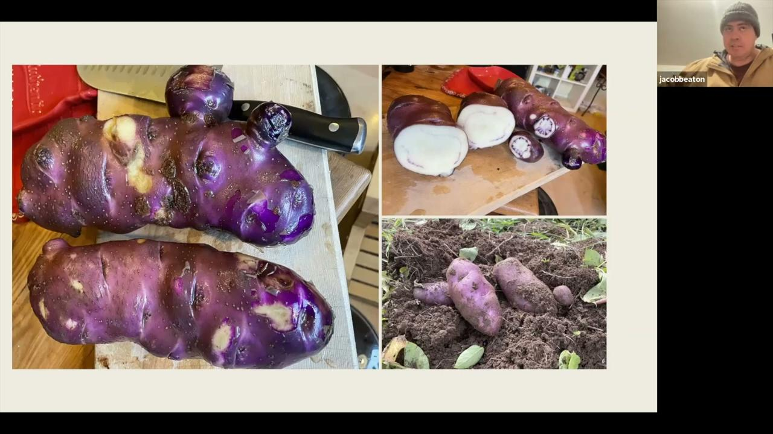
Seed Stories
Indigenous Seed Story - Jacob Beaton Tea Creek
Notes:
Video link is on the Seed Stewardship page of the FFCF website: (Approx 3 minutes)

Slide 8
Activity Ideas
Research an Indigenous creation story that is related to seeds
Interview a family member (guardian, aunt, grandparent) about seeds or a specific vegetable they may have grown and see if you can find the variety available for sale through online catalogues
Plot where a seed has moved through time on a map

